Slide 1

The Mechanization of Nature

Slide 2
The project of the Meditations
Application of systematic doubt.
Response to the revival of the scepticism of Sextus Empiricus
There is something that can be known by the mind independently of sensible experience: “je pense, je suis.” This is the authority of reason.
Also, we can arrive at a basic conception of matter in terms of the geometrical property of extension.
These are the elements of Descartes’ famous substance dualism.
Rationalist vs empiricist schools on the question of the source of knowledge.

Slide 3
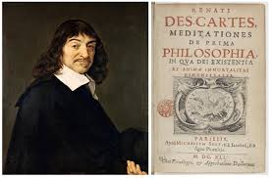
Meditationes de prima philosophia

Slide 4
The Mechanical Philosophy
The guiding assumption of Descartes’ mechanical philosophy: All natural phenom­ena, from the motions of celestial bodies to animal and vegetative life, can be explicated in terms of the geometrical property of extension and its proper modes (size, shape, position, and the disposition of its parts to be moved). Descartes' mechanical cosmology attempts to restate substantive results in optics, astronomy, and in mathematics in order to forge a foundation in physical theory for the Copernican hypo­thesis, which Descartes accepted on account of its simplicity and clarity.

Slide 5
The Relativity of Motion
The idea that motion is relative to a frame of reference is implicit in Copernicus’ anti-anthropocentrism; i.e., from the position of the stars that are situated at enormous distances from the planetary system, the Earth is hardly moving at all.
Galileo defends this principle in a number of places, but especially with a thought experiment about experiments conducted on a moving barge. https://www.youtube.com/watch?v=0YrDXU1Ll4k
Kepler defended this principle in his book, The Dream.
https://www.youtube.com/watch?v=0YrDXU1Ll4k

Slide 6

Descartes and the relativity of motion
If the Earth is carried about in its motion by a fluid medium, it is at rest relative to this medium but in motion relative to the Sun.
Descartes rejected the ordinary idea of motion as "the action by which some body travels from one place to another." If we observe that as much effort is required to put a moving body to rest, as is required to put a resting body in motion, we can see that the suggestion that motion requires an effort, whereas rest does not, is mistaken. It is therefore improper to treat motion and rest as different orders of being and to suppose that one needs more power in order to put in motion a body that is at rest than, conversely, to bring to rest a body that is in motion. "The truth of the matter", Descartes submits, is that motion "is the transference of one part of matter or of one body, from the vicinity of those bodies immediately contiguous to it and considered as at rest, into the vicinity of (some) others." Accordingly, motion is more appropriately conceived as a relational property; i.e., as the change of distance between bodies. Since it is always in contact with bodies that are immediately contiguous to it (i.e., the atmosphere), this definition enabled Descartes to assert that the Earth, properly speaking, does not move.

Slide 7
Descartes and the Causes of Motion
Motion has two causes, a universal and primary cause, and a particular cause that results in corpuscles of matter having some motion, which they previously lacked.
The universal cause is a law of conservation, which is justified by an appeal to God's nature, according to which God always acts in a consistent way, maintaining the same quantity of motion and rest that he put into the world when he first created it. From a consideration of God's immuta­bility, we can arrive at the knowledge of three laws or particular causes of the diverse movements of individual bodies.

Slide 8
Particular causes of motion
FIRST LAW: “each thing, as far as is in its power, always remains in the same state; and that consequently, when it is once moved, it always continues to move." In the absence of external distur­bances, all modes and attributes of matter are conserved from moment to moment in exactly the same state by God's creative concourse. If a particle is moving, it does not come to a stop of its own accord. By the same token, if a body is at rest, it does not simply start moving. This ontological equivalence of rest and motion is the very heart of the new concept of inertia fashioned by Descartes. Motion and rest are similarly positive states of bodies that are conserved in the absence of external actions.

Slide 9
Second law of motion
The first law does not specify in what direction(s), if any, the bodies move.
THE SECOND LAW” "all movement is, of itself, along straight lines ..." The critical insight here is that rectilinear motion is the only direction that can be uniquely and completely defined at a given moment of time. It is therefore the only direction that can be conserved by God in exactly the same way as in the previous moment. Descartes recognized that motion does not take place in an instant of time. However, he reckoned that God conserves a body just as it is in the moment that it is preserved. If, as Kepler had asserted in his New Astronomy that curved motions are the privileged paths described by bodies, this would require that God concern himself with two successive moments of time, an implication that conflicts with the first law of motion. Indeed, if a body were to describe a curved path, this would indicate that some external cause has affected its inertial state. With this law, Descartes dissolved the long-standing problem concern­ing the cause of motion, which sustained medieval impetus theories, and directed scientists to a problem that held the key to the formulation of a celestial dynamics, namely, what causes changes of motion.

Slide 10
Descartes vs Newton on inertia
The two laws both rely on the conserving activity of God. Together they hold that God conserves a quantity of action, determined in a unique direction, which is maintained from one moment to the next. Motion is therefore, on Descartes' account, a series of actions that occur at discrete moments of time. Moreover, this action at a moment of time is not the cause or reason of subsequent actions. Although Descartes is rightly credited with the law of inertia, the very foundation of the modern science of dynamics, motion in a straight line is not uncaused, as Newton will assert a half-century later, but is supported by the conserving activity of God.

Slide 11
Descartes and the mechanics of circular motion
When we whirl a stone in a sling, it tends to recede from the center of motion. Planetary motion is a result of the interaction of two actions: an inward pressure from densely packed material and a centripetal tendency to move outward from the center. The path described by the planets ia a balance between these two actions.

Slide 12
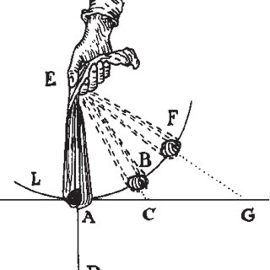
Motion in a Sling (Descartes)

Slide 13
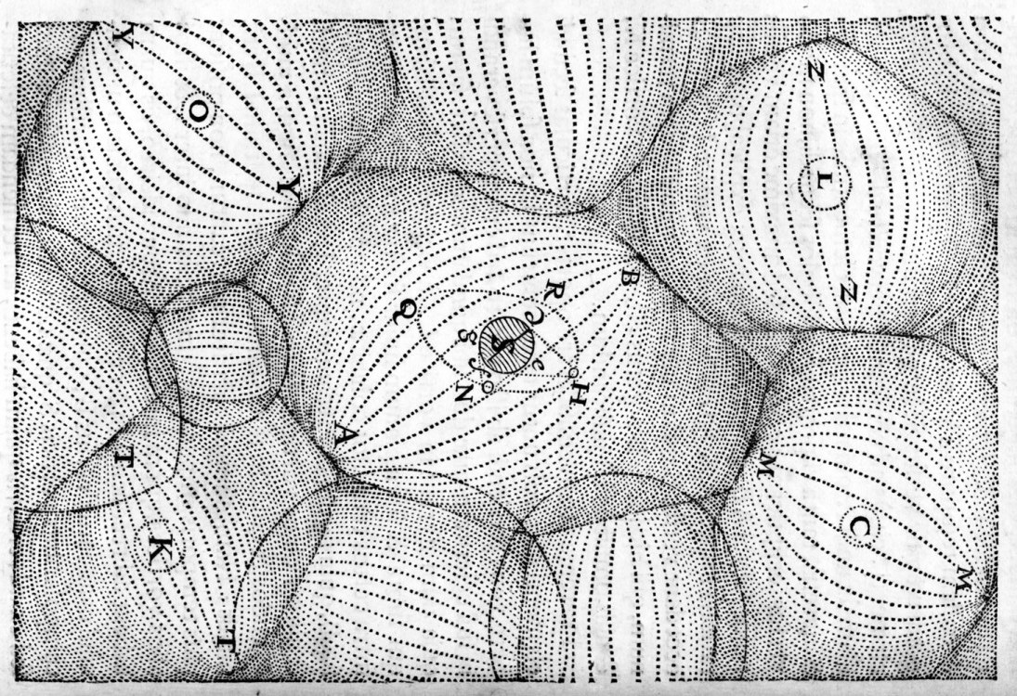
The Vortex Theory of Planetary Motion

Slide 14
Bacon and the Great Instauration
Global reform of the sciences. Call for a new beginning and a rejection of the teachings of the ancients, the schools, etc.
Incorporates a notion of progress that is new and would be one of the guiding principles of the Enlightenment.
Progress: change that is directed and desirable.
Evolution: change that is not directed.

Slide 15
Collaboration in the search for knowledge
The ideal of the new experimental practice that bloomed during the seventeenth century is that science is an imperfect body of knowledge that can be remedied and perfected by many hands, spanning many generations of practitioners. This ideal of the collaborative character of scientific practice was a cornerstone of the new seventeenth century experimental philosophy of nature. It is an ideal that seeks to balance theory and practice, the power of reason and experience, and two different cultures that shared a common goal and a project.

Slide 16
Bacon’s Legacy
Bacon championed the new generation of natural philo­sophers with the emphasis on observation and experiment, and a disdain for those who would defer to the authority of the ancient philosophers. Experiment would allow humanity to control nature.
Bacon showed no appreciation of the great scientists of his day — Gilbert, Copernicus, Galileo, Kepler, or even Harvey, his personal physician — but his inspiration led directly to the formation of The Royal Society.

Slide 17
Inductivism/experimentalism
Induction is a form of inference (particulars to generalizations). Bacon self-described as an inductivist (as did Newton), but for Bacon inductivism was a method of arriving at scientific knowledge through the use of experimental procedures that would be grounded in the phenomena of nature (i.e., general truths that are revealed to us through experiment).

Slide 18
Bacon, Newton, Robert Boyle, and alchemy
For the Aristotelian, an object is a union of form and matter. These forms are viewed as immutable and unchanging.
Alchemists were convinced that these forms can be transmuted, one into another. An inferior metal (e.g., lead) could be converted into a nobler metal (silver or gold) given the application of appropriate scientific procedures .
Alchemists were deeply suspicious of observation simply because a form could change from moment to moment.

Slide 19
The Royal Society
About fifteen years after the publication of Bacon’s Novum Organum, a group of individuals began to meet weekly to discuss problems in natural philosophy. In the disturbed times of the Restoration, the meetings were scattered and uncertain but were resumed at Gresham College, London. In 1662, Robert Hooke was appointed Curator to the Society. As Curator, his job was to provide “three or four considerable experiments” each day the Society met. Hooke knew most of the instrument makers of London, and his inventions and their skill helped to inspire and provide for the new interest in natural philosophy. Instruments and machines were designed, constructed and purchased. Hooke’s work with the microscope and Newton’s work on optics and astronomy stimulated the optical instrument trade.

Slide 20
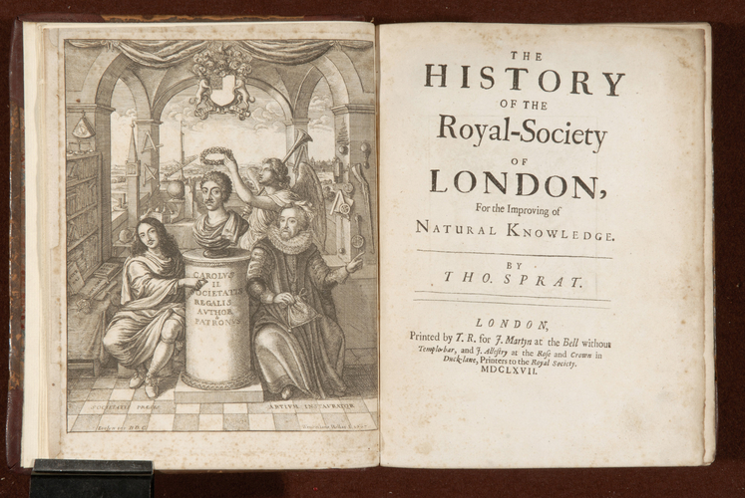
Frontispiece of Spratt’s History of the Royal Society

